Slide 1
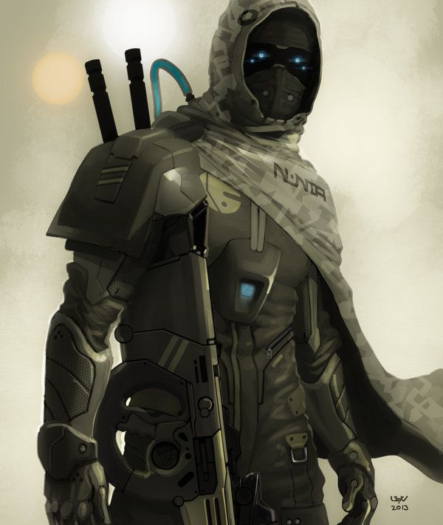
Dead of Night
A Free to play Rogue-like Stealth Mobile game

Slide 2

Table of contents
01
Overview
02
Gameplay
03
Monetization and Customization
04
Target audiences

Slide 3
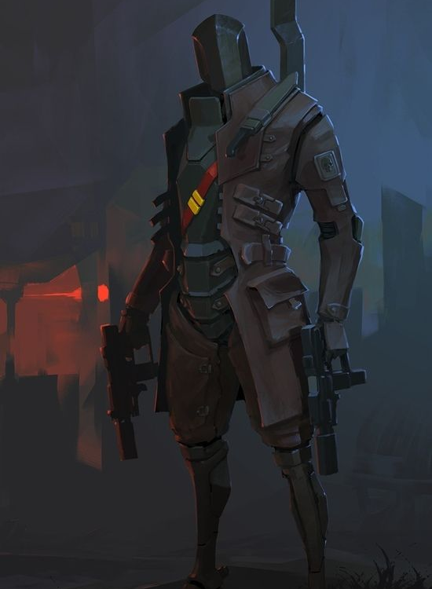
Overview
"Dead of Night" is a 3D third-person thrilling stealth adventure set in a dystopian future. Players play the role of a skilled assassin tasked with infiltrating and bringing down a corrupt dictatorial regime. This game delivers a heart-pounding experience that will keep players engaged for hours on end, with a focus on strategy, stealth, and action.

Slide 4
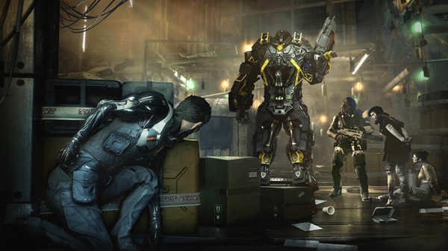

Gameplay
Stealth
Rogue-like
Stealth and strategy are key. To accomplish objectives, players must develop plans utilizing gadgets and weaponry while avoiding alerting opponents.
Every time the player dies, they will be sent back to the first floor and the tower will change its structure after every death.

Slide 5
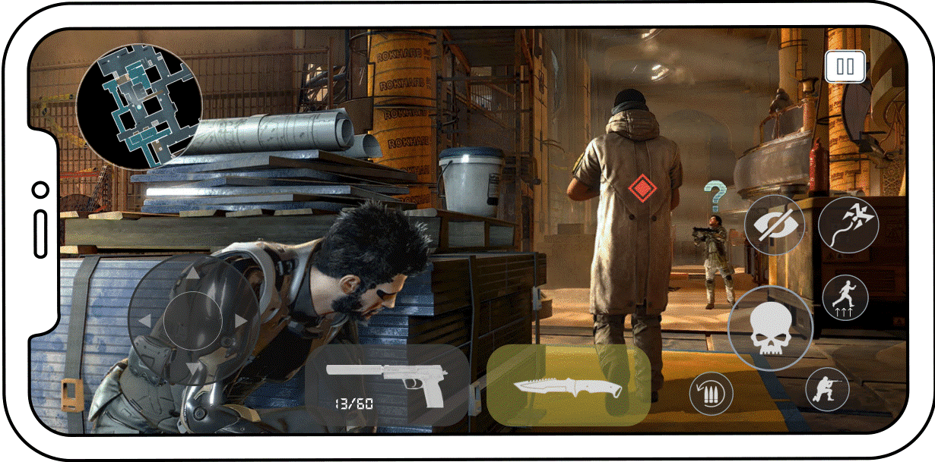
Gameplay Interface Mockup

Slide 6
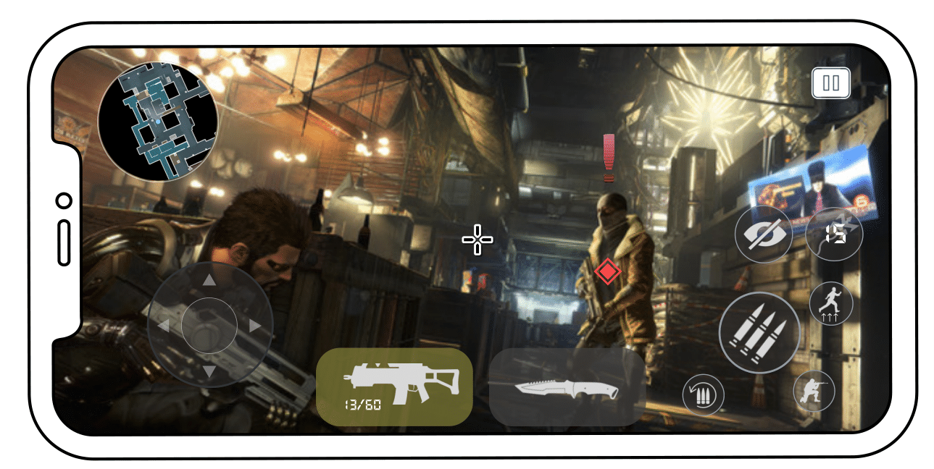
Gameplay Interface Mockup

Slide 7
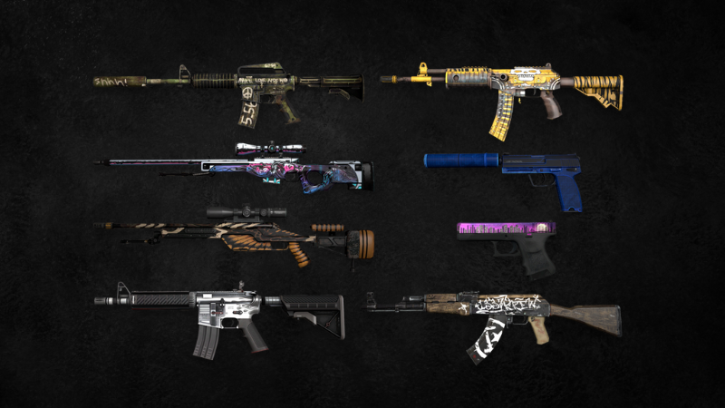
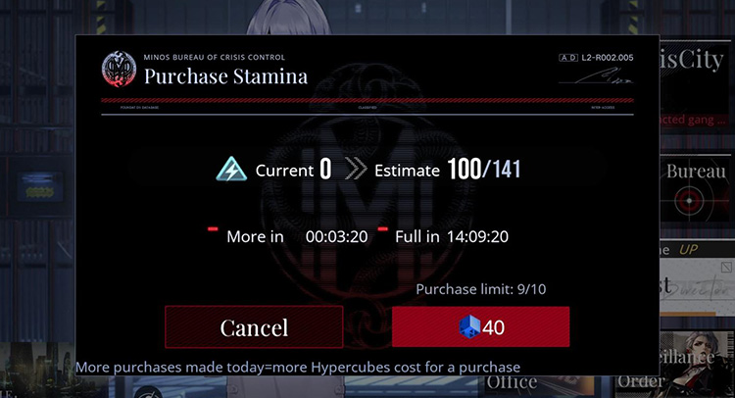
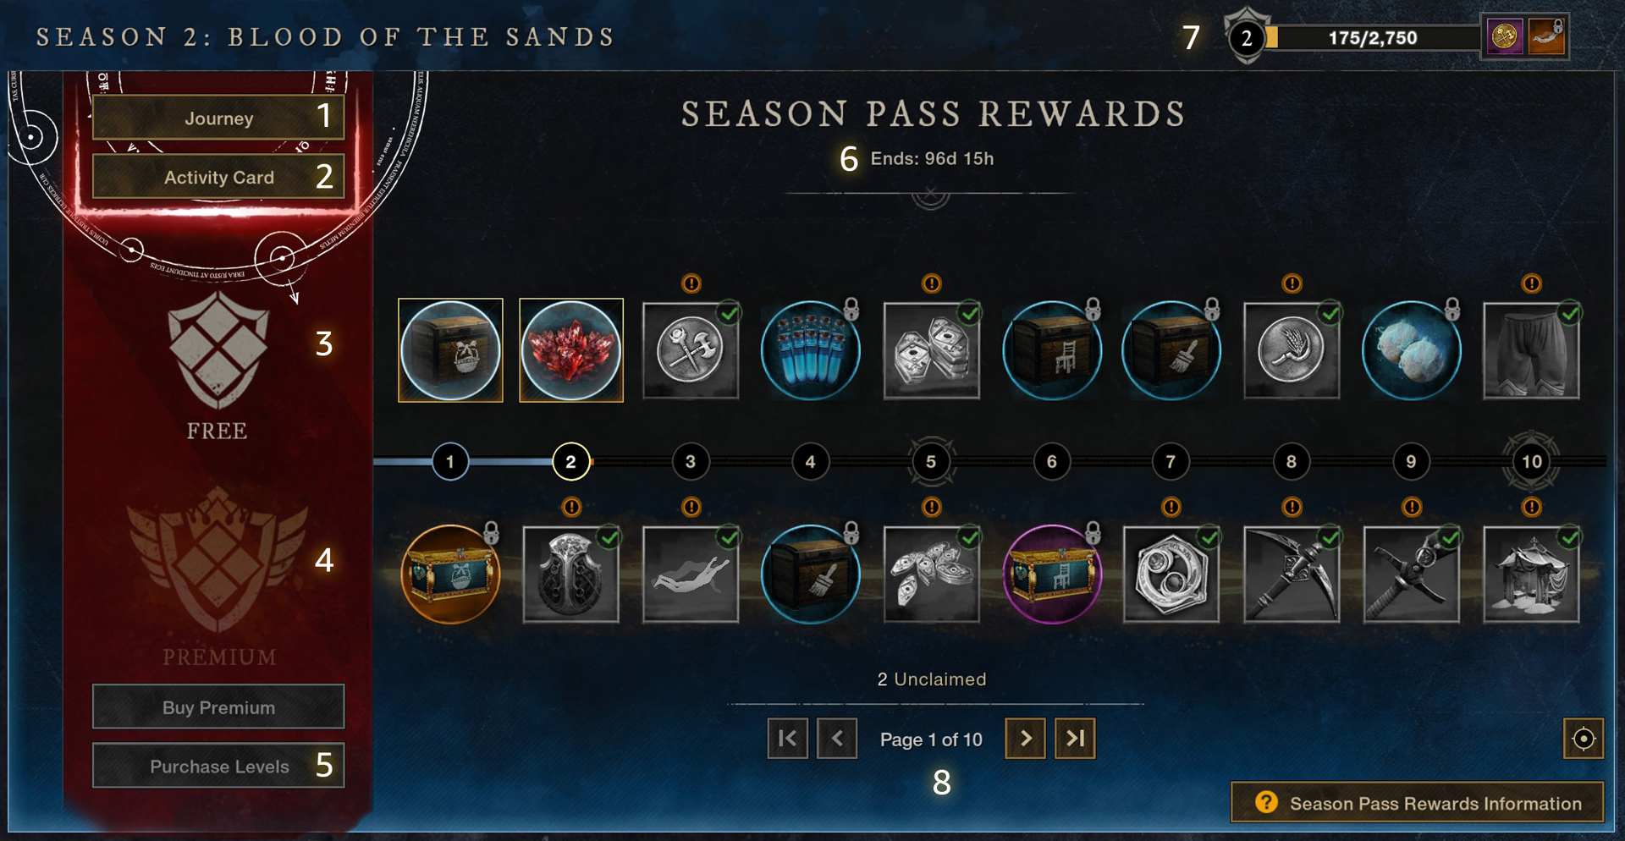
Monetization
Cosmetics
Season pass
Stamina and Buffs
Guns and gadgets cosmetics will be available through loot boxes, which can be purchased with real money or earned through gameplay.
Players can purchase
stamina and buffs through the store using real money.
Offer time-limited season pass that players purchase to gain bonus cosmetics, gear, resources, and XP boosts as rewards.

Slide 8
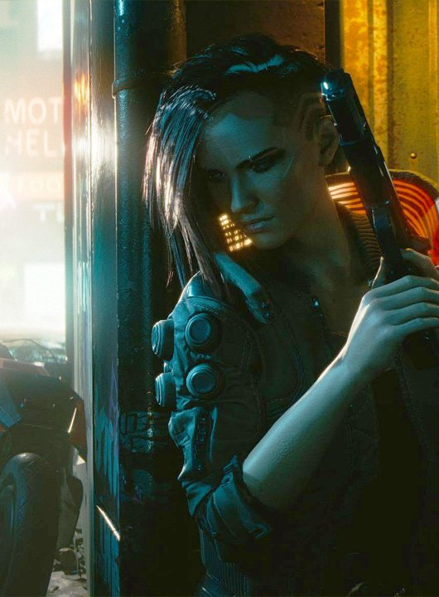
Target audiences
Fans of stealth games like Metal Gear Solid, Splinter Cell, Hitman
Fans of Cyberpunk theme games.
Players seeking a mobile challenging stealth experience
Tactical shooter fans interested in non-combat approaches

Slide 9
Thank You
Huynh Nguyen Quoc Bao Tel: 0707191380
Email: baohnq2003@gmail.com Facebook: Bảo Nguyễn LinkedIn: Huynh Nguyen Quoc Bao

